Slide 1
Driver refresher
Bill Cumpston
October 2016
Notes:
This presentation assumes that people have some familiarity with SmartMove. i.e. have used it at least once.
This talk will not cover everything. Please ask questions if there is anything you want to know.

Slide 2
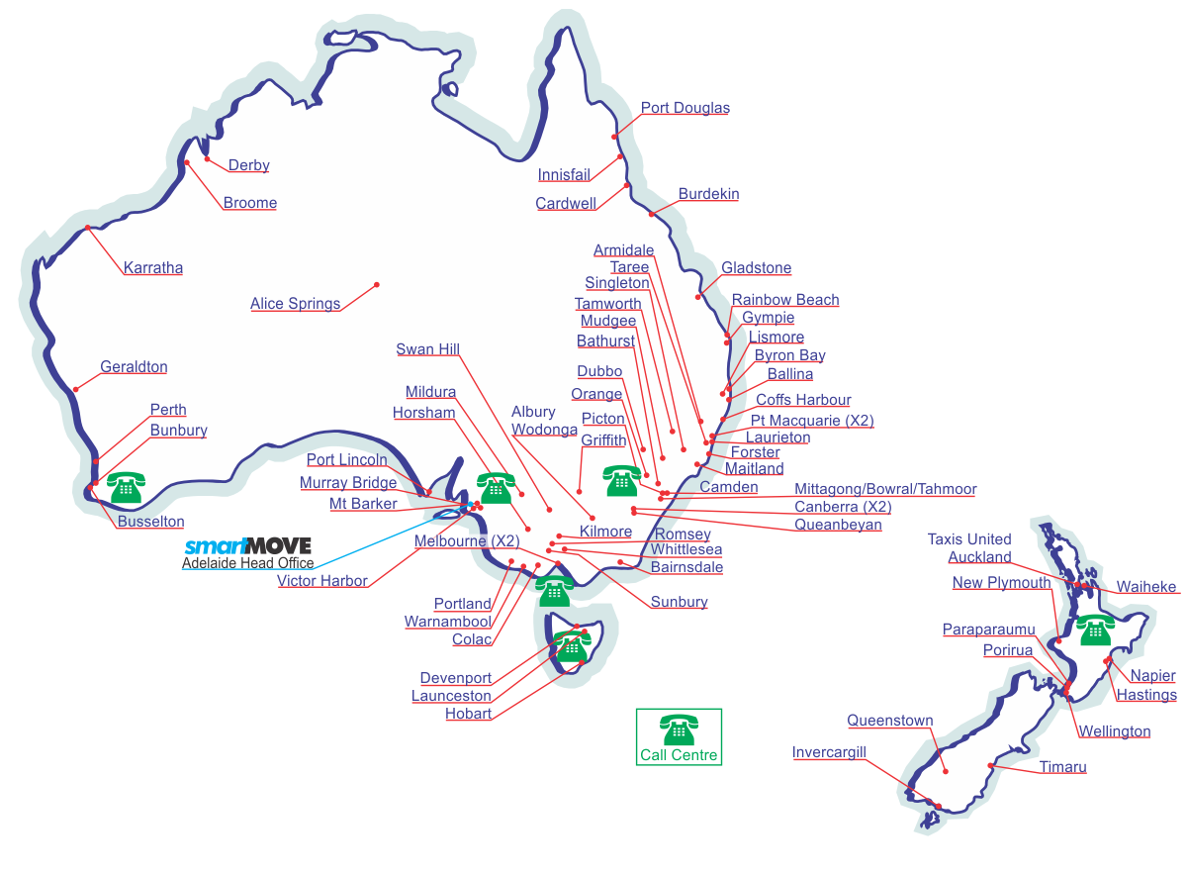
SmartMove fleets
Notes:
At start of 2012
Designed/built/supported in Adelaide.
Ideally suited for small to medium fleets. User base has grown steadily. Now recognised as the leading system for country areas.

Slide 3
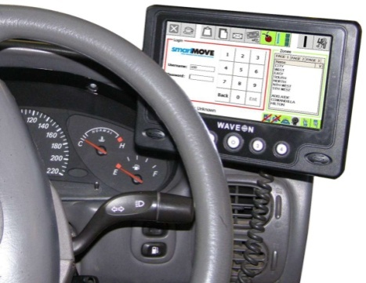
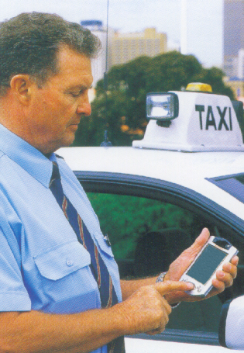
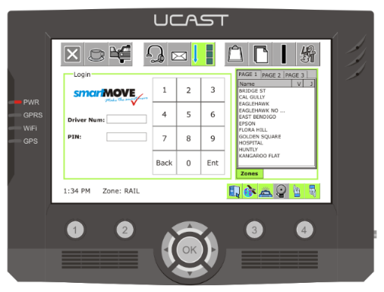
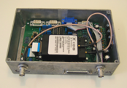
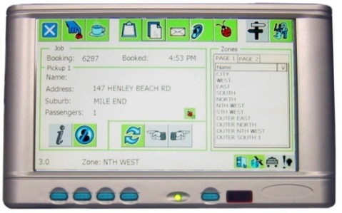
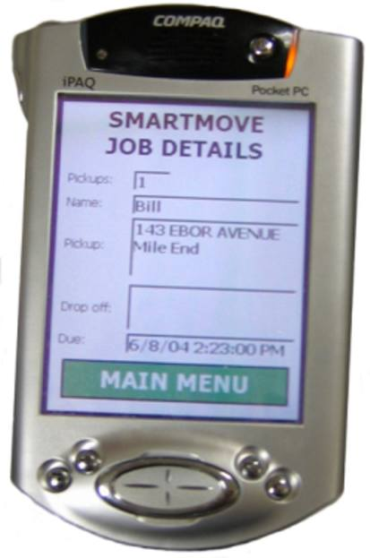
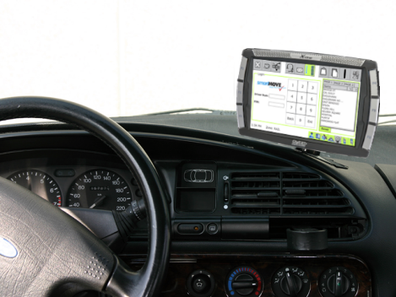
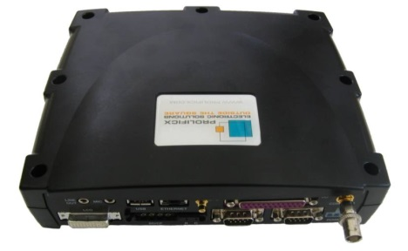
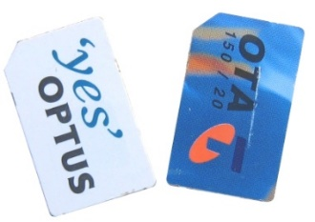
Evolving Technology
Notes:
Equipment has changed over the years
Started with PDA + box made by the Russians
Switched to TrakPod designed in New Zealand. Ahead of its time but not reliable. GPS very slow and screen chip failed.
Neither phone company is 100% reliable but problem solved with dual SIMs.
Used Waveons designed in Singapore. Had box under the seat. Problem with batteries and memory loss. Only 2G.
Switched to UCASTs. Also designed in Singapore. Single unit. Reliability a major issue. ~20% failed on arrival! Some units had major connection problems.
Now using Digitax – designed and built in Italy. Very reliable.
But things have turned a full circle – can now get SmartMove on a phone.

Slide 4
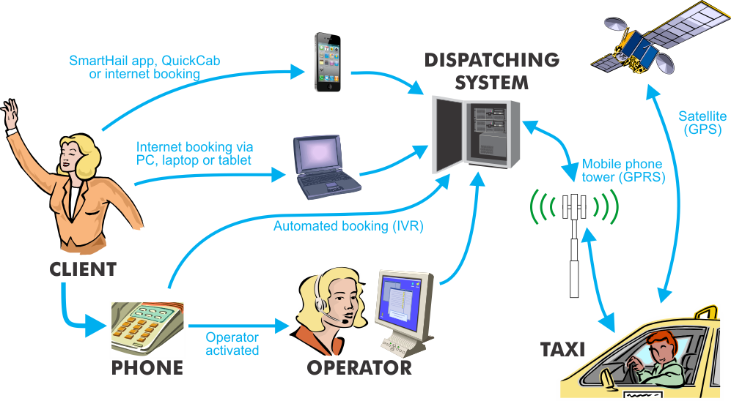
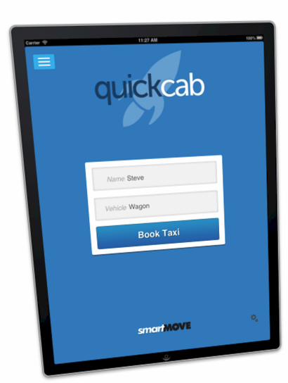
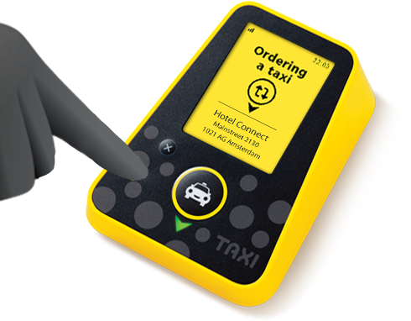
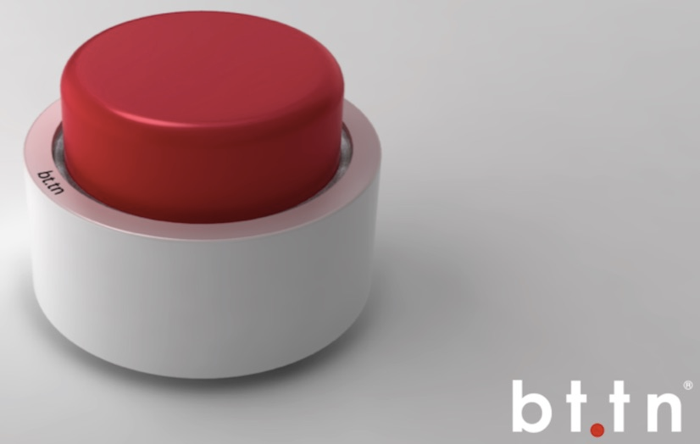
SmartMove Overview
Notes:
Taxi get their position and report in. Happens every minute or every 300 metres.
Result: You can be 300 metres into a new zone before the computer notices.
Communication is done over the mobile phone network. Generally use Telstra but will switch to Optus/Vodafone if no connection.
Unit flips between the two carriers when trying to get a connection. You might end up on Optus if you come back from an out-of-town trip.
There are various ways for booking to be made: operator, SmartBooker (IVR), recurring (repeat/permanent), phone app, web bookings, quickcab and button.
Various options aiming to make is easy for passengers to make a booking.

Slide 5
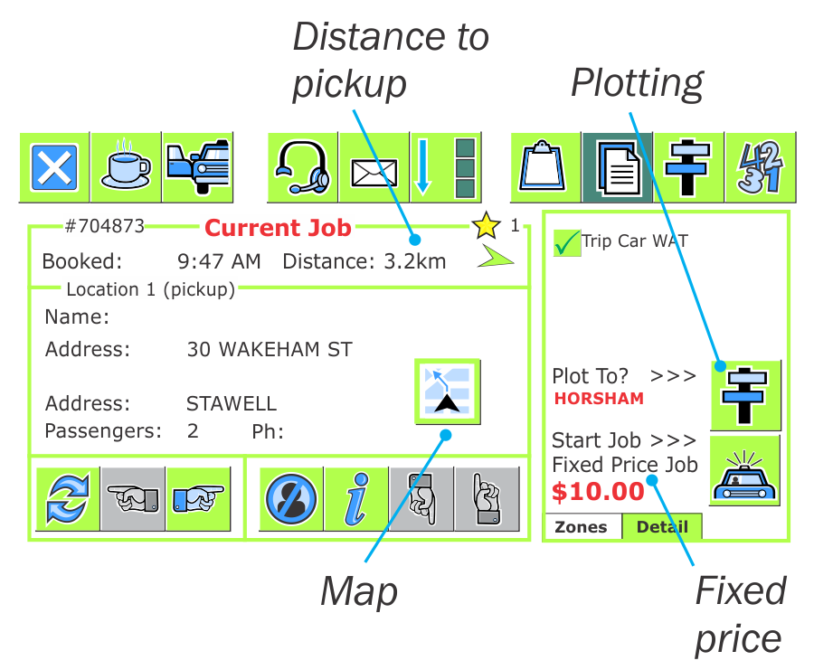
Job details
Notes:
Start with something easy. This is the most useful screen for earning your income.
The distance to pickup is useful when trying to find the right house.
You should plot whenever possible, particularly if going out of town. It prevents a vacant car being sent after you.
Navigation is now available. Like a Tom Tom.
Fixed price jobs should be done on the screen.
Navigation can be done with your phone – covered in driver app later.
Any questions on this screen?

Slide 6
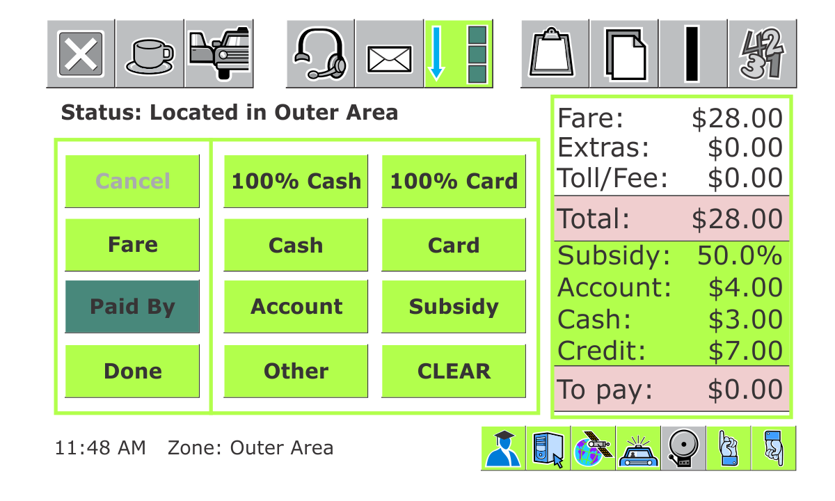
Payment screen
Notes:
The payment screen appears at the end of each job. You must have the “To pay” value at zero (or less) before you can press the Done button.
Simply record how the fare was paid. Use CLEAR if you make a mistake.
It is possible the payment details will be there already. You don’t have to enter them again.
You can adjust the fare if you need to but be aware that the original amount is recorded.

Slide 7
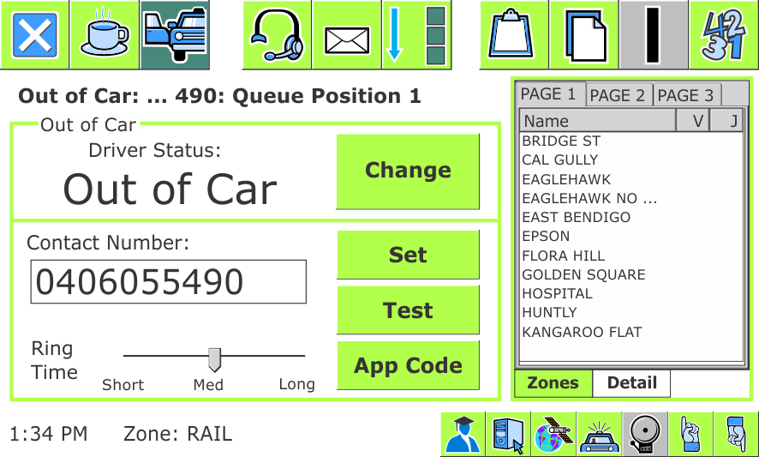
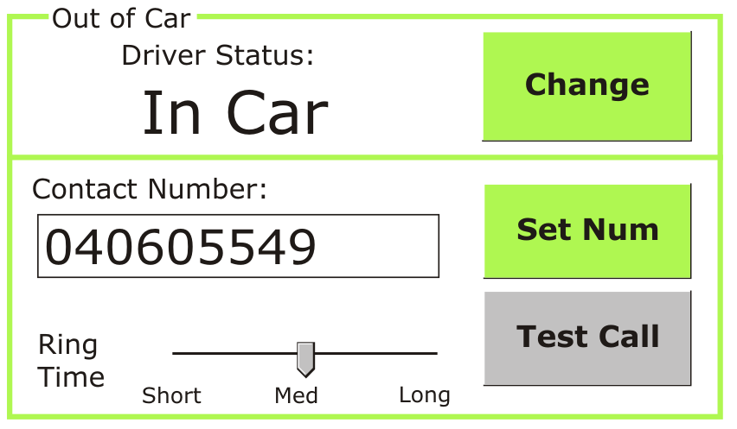
Out of car alert
Set your own mobile number
Tells system you’re away from car
Use it whenever you want to leave the car
Notes:
Very popular feature
Computer rings phone when a job offer is made. DON’T ANSWER the call.
It turns off after an offer is made.
Note the App Code – this is for the driver app that we will discuss later.

Slide 8
Extended Statistics
Notes:
Now have two statistics screens: small one on front screen and more detailed one available through the menu.
Can change which screen is shown when the 1/2/3/4 button is pressed – discussed later
Can also have the more detailed one appear automatically at the end of each job – also on next slide.

Slide 9
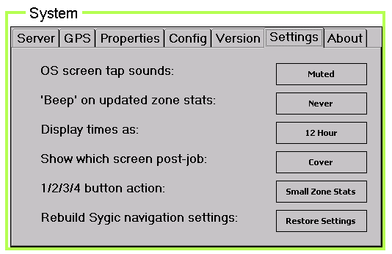
System: Options
Notes:
You have a few options on how the unit operates.
12/24 hour times
Show stats page at the end of the job instead of the cover page.
What the 1/2/3/4 button does.
Don’t be afraid to try things.

Slide 10
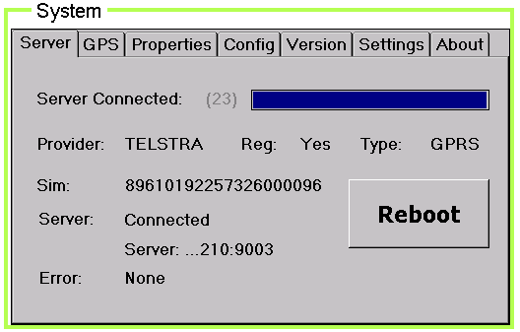
System: Server
Notes:
You can check if you are on Telstra. Do this if you think the connection is poor.
The Server page will tell you which carrier you are using.
The Version page lets you switch to the other carrier.
The Properties page tells you which carriers you have.

Slide 11
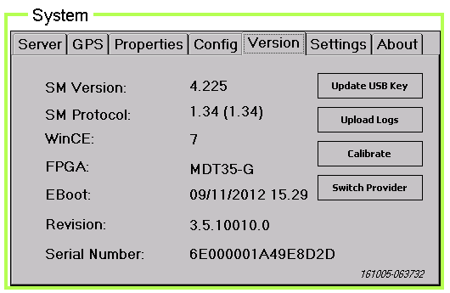
System: Version
Notes:
You can check if you are on Telstra. Do this if you think the connection is poor.
The Server page will tell you which carrier you are using.
The Version page lets you switch to the other carrier.
The Properties page tells you which carriers you have.

Slide 12
Dispatching
Notes:
12
The dispatching has two sets of rules.
First is based on zones and layers.
Second is based on distance. (cover)
First we look in the pick-up zone. Job is given to the car that has been vacant longest in the zone. This is the only time queue position is relevant.

Slide 13
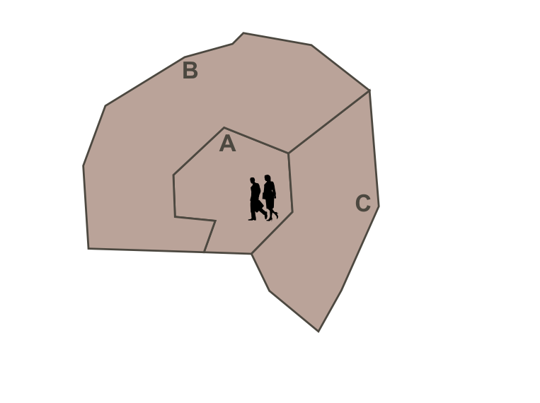
Dispatching
Notes:
13
Next we look in the adjacent zones nominated in the layers. In this example we look in zones B and C as they are the next layer.
Job is given to the car that has been vacant longest in this enlarged area. It may not have queue position 1.

Slide 14
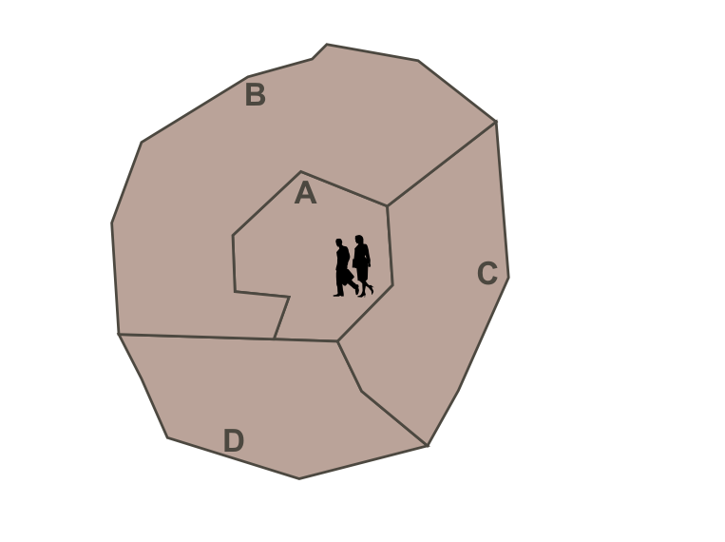
Dispatching
Notes:
14
We try another layer. In this case D.

Slide 15
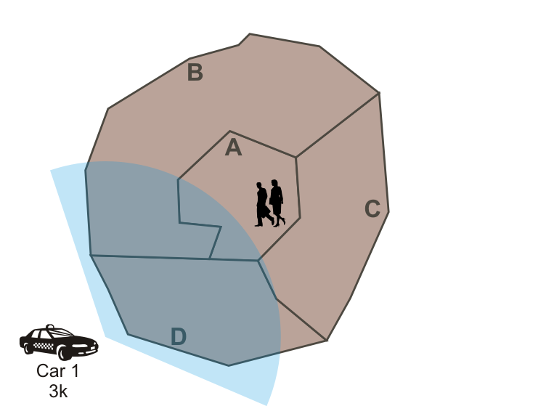
Dispatching
Notes:
15
Dispatching
Search layers first in the order specified by the fleet.
When there are no more layers we look for a car that is prepared to travel. In this example car 2 will get the offer as car 1 has indicated that he is not prepared to travel.
However for most fleets the job will eventually be offered to car 1 – bookings can be auto-escalated by the system if they have been waiting too long, perhaps by looking for the closest car after 15 minutes.
If "no location" is set in the booking then job goes to closest car. Can also apply to WAT and Maxi work automatically as an option.
It is possible to limit the number of times an offer is made.
Penalties are intended to encourage people to take work. There is no penalty for "no show" if the driver is near the pickup point.

Slide 16
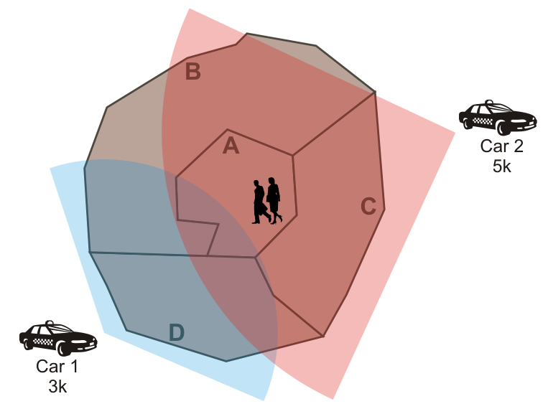
Dispatching
Notes:
16
Finally, when there are no more layers look for a car that is prepared to travel. In this example car 2 will get the offer as car 1 has indicated that he is not prepared to travel that far.
There is no penalty for refusing a cover job.
If "no location" is set in the booking then job goes to closest car. Can also apply to WAT and Maxi work automatically as an option.
It is possible to limit the number of times an offer is made.
Penalties are intended to encourage people to take work. There is no penalty for "no show" if the driver is near the pickup point.
Note there is normally not much point in having short cover distances as close jobs will normally be covered by the layers.

Slide 17
Dispatching rules
Eligible
Connected (hold pos: 30mins)
Logged in
Meter not engaged
Panic off
Available (hold pos: 10mins)
Not penalised (reject: 30secs, resubmit: 2mins)
Not signed off (suspended)
Not currently assigned a job
Not currently considering an offer
Capable
Category
Capacity
Notes:
Summary: computer will only offer work to a car if the car is available and suitable.

Slide 18
Blacklists
You can blacklist a passenger = phone number
You can blacklist an address
The passenger can blacklist a driver (but not a car)
The fleet can blacklist a passenger, address, street, area, place name
Notes:
Will give you a list of the blacklist entries that you have set.

Slide 19
Create Job
Notes:
This page lets you put a booking in the system.
You have three choices:
- Use the details from the last job. Useful if you want to book the return trip. Use the REVERSE button.
- Make a booking for your current address. Don’t use it when driving down the road!
- Create a new booking.
Some fleets allow the booking to be reserved for the driver making the booking.
The $ EST button is available only if both pickup and destination addresses are given.

Slide 20
Lost Property
Notes:
You can record that you have found some lost property. This makes the base operator aware that the item has been found in case the passenger rings and asks.
Tick the appropriate items
Add a note if appropriate
Press confirm.

Slide 21
Panic Tester
Notes:
Used to test the panic button.
Quick press lights up first image. confirms button is working
Longer press lights up the second image and sends the panic alarm to the base. Base operator is informed that it is a test.
Third image lights up when the computer acknowledges the alarm.
Reset when finished.
You should do this from time to time to confirm that your unit is working correctly.

Slide 22
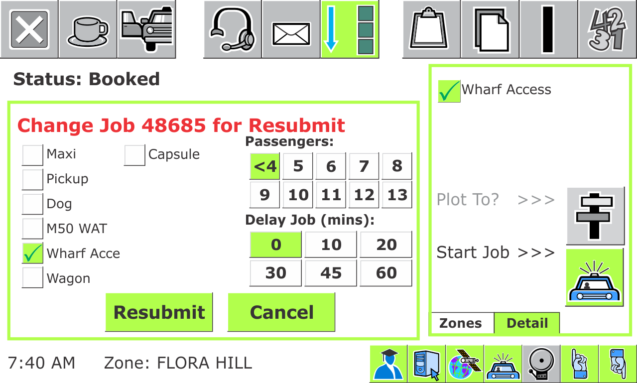
Resubmit with Change
Notes:
If you can’t do the job you should correct the details before resubmitting the job.

Slide 23
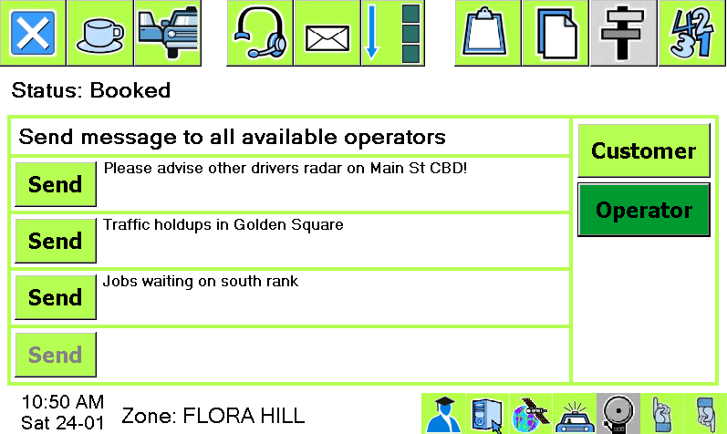
Send message to base operator or passenger
Notes:
The operator can send you a message. Now you can send a message back (if it has been enabled).

Slide 24
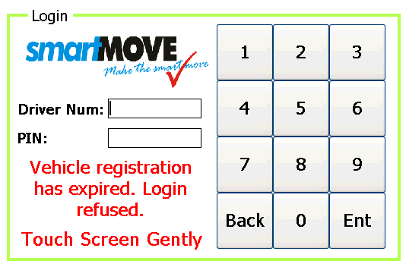
Legal Obligations
Used to ensure driver is licensed
Can check anything with an expiry date
Driver’s license
Accreditation
Vehicle registration
Vehicle inspection
Notes:
Anything with an expiry date can be checked.

Slide 25
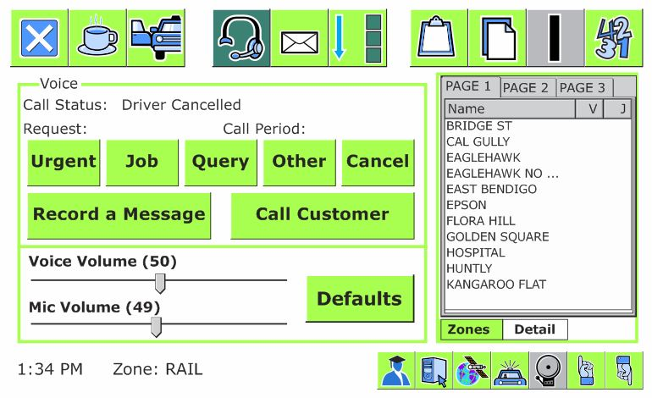
Operator requests
Users to request voice connection
Urgent — urgent request
Job — new job
Query — question about job
Other — other request
Panic button. No jobs until reset.
Notes:
Can request call to base. Same as hands-free voice call with mobile phone. Operator has to accept request.
Can record a message.
Can call customer if that is allowed. There is a charge.

Slide 26
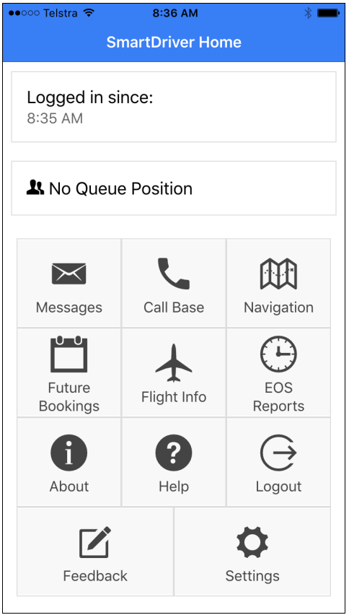
SmartDriver app
SmartMove
Provides additional functionality
Get end-of-shift report
Notes:
We now have an app that the drivers can use.
Intention is that we provide extra features that are useful when not in the vehicle. Currently have
Messages
Future work (if allowed)
End-of-shift report
Job offer notification – can accept but you need to return to the car and accept again
Navigation if people prefer to use the phone navigation system

Slide 27
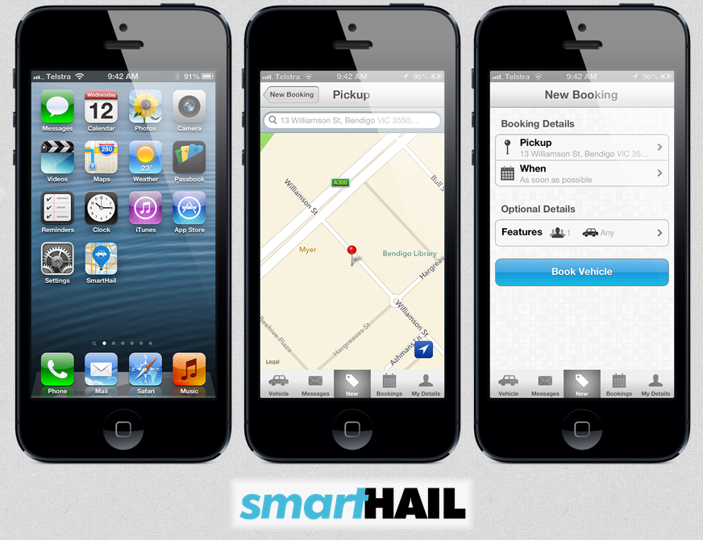
Smartphone App
Notes:
The SmartHail app allows passengers to book a cab.
The passenger can see you coming. Please do the job!
In future fleets can have their own branded app if they want.

Slide 28
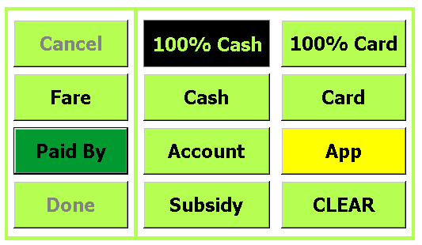
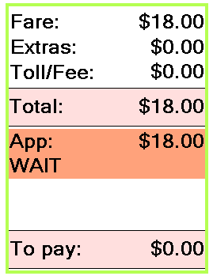
Credit Card Payments with the App
Notes:
Soon passengers will be able to pay for a trip using their app.
For small fares there is a fee for this.

Slide 29
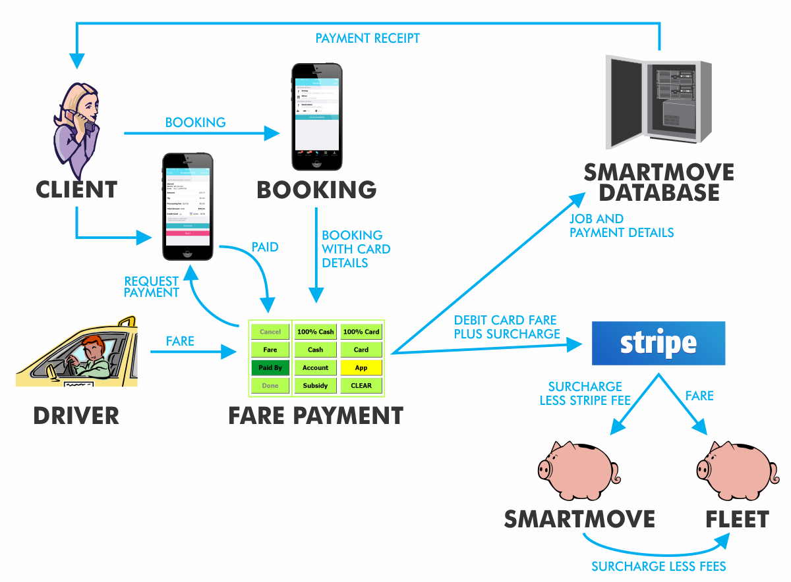
Credit Card Payments
With booking
With app
Notes:
Credit card payments will be the next major change in SmartMove.
Credit card supplied at time of booking
Credit card details recorded in app so that app bookings can be paid for with the app. Driver doesn’t handle card.
(Later) App can be used to pay for any booking.
Fleets will get any profit, but it isn’t clear there will be any in the future. ACCC are mandating that merchants can’t charge more than it costs.
DEMO with $25 fare.
DEMO with model booking at $47 fare

Slide 30
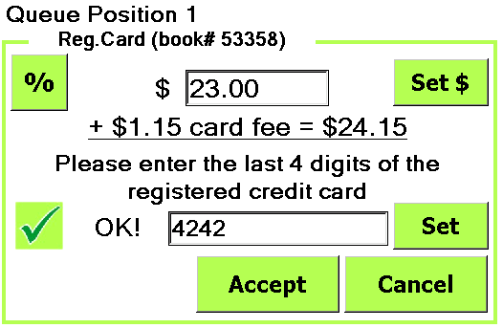
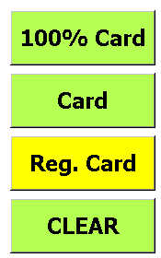
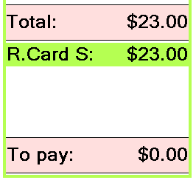
Bookings Paid with Credit Card
Notes:
If a credit card has been supplied at the time of booking it can be charged at the end of the trip.
You must enter the last four digits of the card. This is to ensure that the right passenger is on board.
You will be told that the debit has been approved.

Slide 31
Driver’s Handbook
Notes:
The driver handbook contains a brief description of all the major screens.
The on-line tutorials cover many topics. You will not miss out on work when looking at these.

Slide 32
QUESTIONS?
www.smartmovetaxis.com

Slide 33
THANK YOU
www.smartmovetaxis.com

